Slide 1

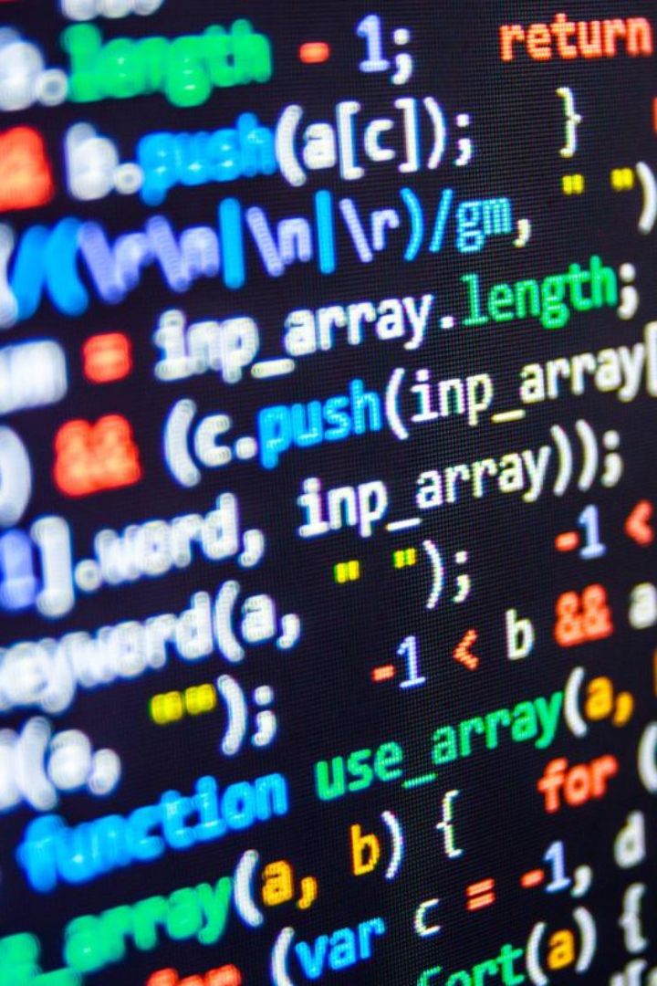
Introduction to Pointers in C language
Pointers are one of the core components of the C programming language. A pointer can be used to store the memory address of other variables, functions, or even other pointers. The use of pointers allows low-level memory access, dynamic memory allocation, and many other functionality in C.

Slide 2

Definition of Pointer in C Language
Pointer is a variable that stores the memory address of another variable. It is used to access the value of a variable indirectly, by using the memory address instead of the variable itself. Understanding pointers is crucial for writing efficient and powerful C programs.
Also we can define: A pointer is defined as a derived data type that can store the address of other C variables or a memory location. We can access and manipulate the data stored in that memory location using pointers.

Slide 3

Structure of Pointers
Memory Address
Data Type
Pointers store the memory address of a variable, allowing direct access to its value.
Pointers have a data type associated with the variable they point to, indicating the size of memory to be accessed.
Null Value
Pointers can be assigned a null value, indicating that they do not currently point to any valid memory address.

Slide 4

Pointer Declaration and Initialization
1
Syntax
2
Initialization
Pointers are declared using an asterisk (*) before the variable name. Example: int *ptr;
Pointers can be initialized with the address of a variable using the & operator. Example: ptr = &num;
3
Initialization with Null
Pointers can be initialized with a null value. Example: int *ptr = NULL;

Slide 5
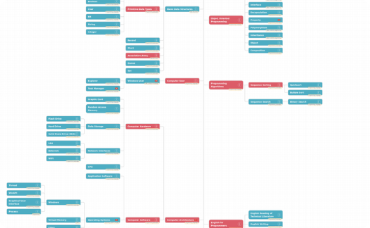
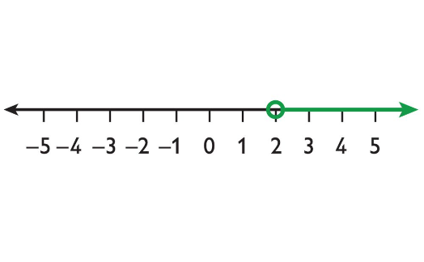
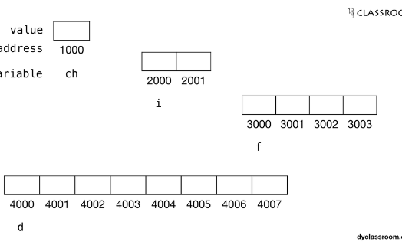
Address-of (&) and Dereference (*) Operators
& Operator
* Operator
* Operator in Assignment
The & operator retrieves the memory address of a variable. Example: int *ptr = &num;
The * operator dereferences a pointer and accesses the value stored at the memory address it points to. Example: int value = *ptr;
The * operator can be used in assignment statements to modify the value at the memory address pointed to by a pointer. Example: *ptr = 10;

Slide 6

Why Pointers
Dynamic Memory Allocation:
1
2
Efficient Data Manipulation::
Passing Addresses to Functions:
3
2
Efficient Array Handling:
Dynamic Data Structures:
3

Slide 7
Examples of Pointer Usage
Dynamic Memory Allocation
Passing Pointers to Functions
Accessing Array Elements
Pointers can be used to traverse and manipulate arrays efficiently.
Pointers allow for the allocation and deallocation of memory at runtime, enabling flexible data structures.
By passing memory addresses, functions can directly modify variables, reducing unnecessary copying of data.

Slide 8
Exercises for Basic Pointer Skills
Exercise 1
Declare a pointer variable named "ptr" of type float.
Exercise 2
Initialize the pointer "ptr" with the address of a float variable named "num".
Exercise 3
Assign a value of 10 to the memory location pointed to by "ptr".

